Slide 1

“Performance Analysis of Battery Management System used for Electrical Vehicles” Minor Project Review 2
By
Nistha Kumari (18BEE063)

Slide 2
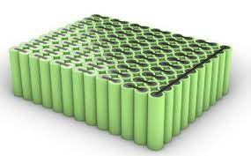
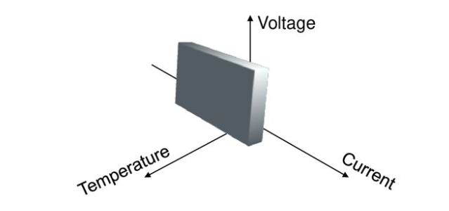
Chapter 1: Introduction
Society’s mobile devices usage grows on a regular basis making the study of batteries a really important subject. The longevity of battery charges is nowadays a big issue for people who are usually outdoors. Electric Vehicles (EV), a worldwide growing market, are pretty dependent on batteries capacity and usage as EVs can only go as far as the battery allows
Home battery devices that can store energy from either local renewable sources or from thegrid are also a promising technology highly dependent on battery usage patterns.
In a battery pack, all cells are unique and as time passes by, every cell in a battery pack will age particularly beginning contrasts between each other while charging them. Albeit equal cells are self-adjusted, that doesn't occur when placing them in series.
Some battery adjusting strategies were proposed in writing, to make a framework fit for applying a charging calculation. The strategy introduced in this paper is in light of the most habitually utilized adjusting framework.

Slide 3
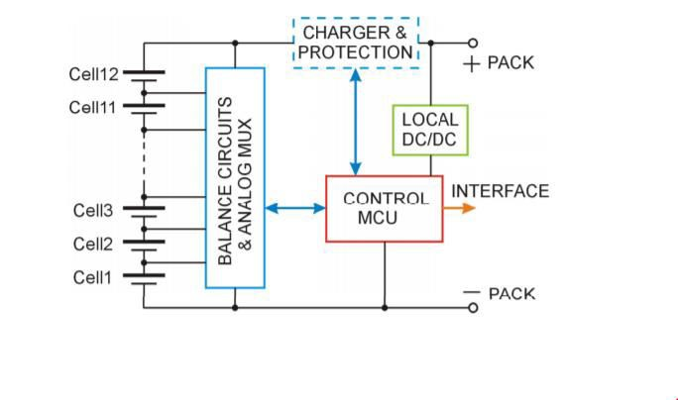
Chapter 2: Balancing methods
There are two main methods for battery cell charge balancing: passive and active balancing. The natural method of passive balancing a string of cells in series can be used only for lead- acid and nickel-based batteries. These types of batteries can be brought into light overcharge conditions without permanent cell damage. When the overcharge is small, the excess energy is released by increasing the cell body temperature. The excess energy can be released by the external circuit connection in parallel to each cell. This circuit consists of a power resistor connected in series with a control MOSFET transistor. This method can be used for all types of batteries, but is effective for a small number of cells in series.
The active balancing method is based on the active transport of the energy among the cells. This balancing method does not depend on the chemical characteristics of the cells, and can be used for most types of modern batteries. There are several types of active balancing methods based on the type of energy transfer.
The energy transfer can be from one cell to the whole battery, from the whole battery to one cell, or from cell to cell. Each energy transfer is based on the type of dedicated DC-to-DC converter. The energy is transferred from the strongest cell to the whole battery or other cells, and from the battery or other cells to the weakest cell.

Slide 4
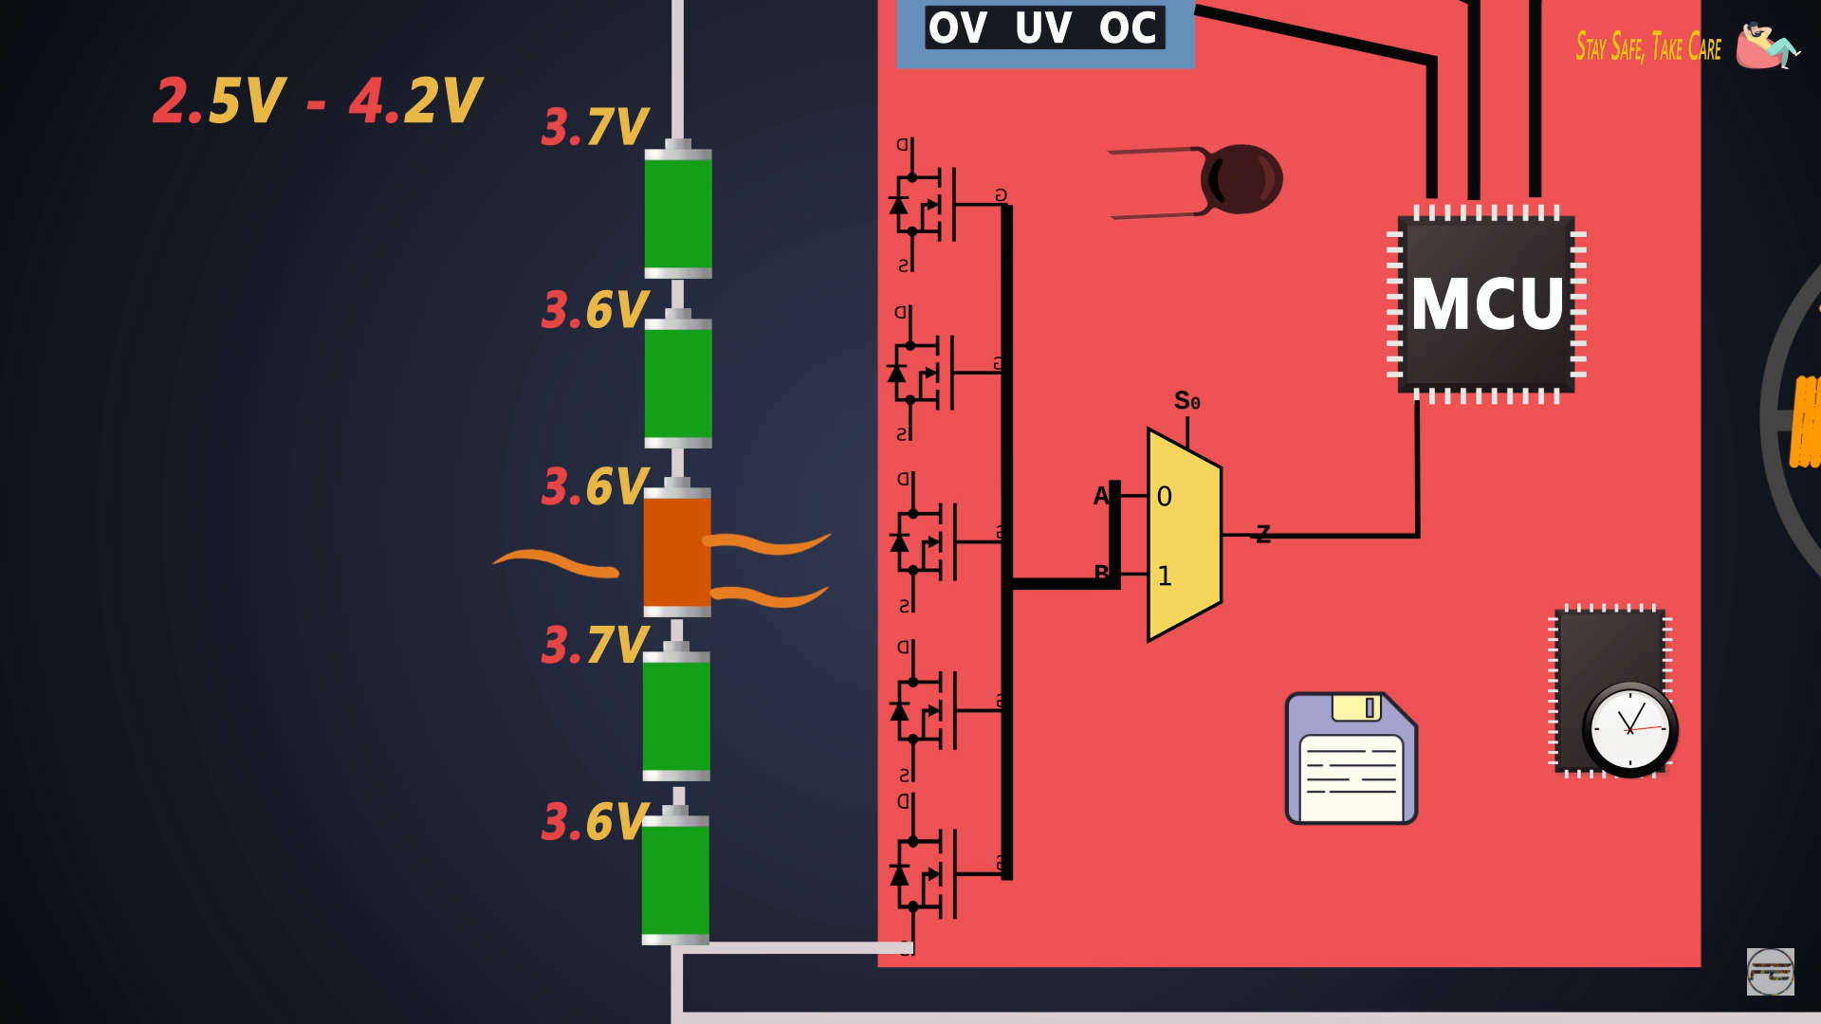
Basic figure of what is inside a BMS

Slide 5
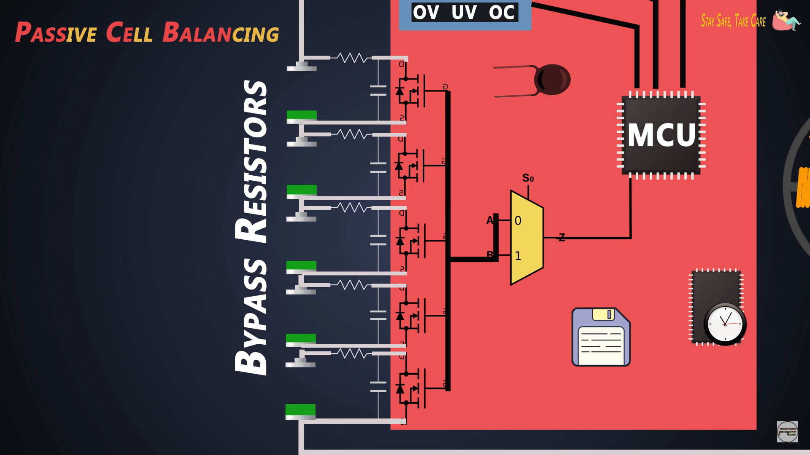
PASSIVE CELL BALANCING

Slide 6
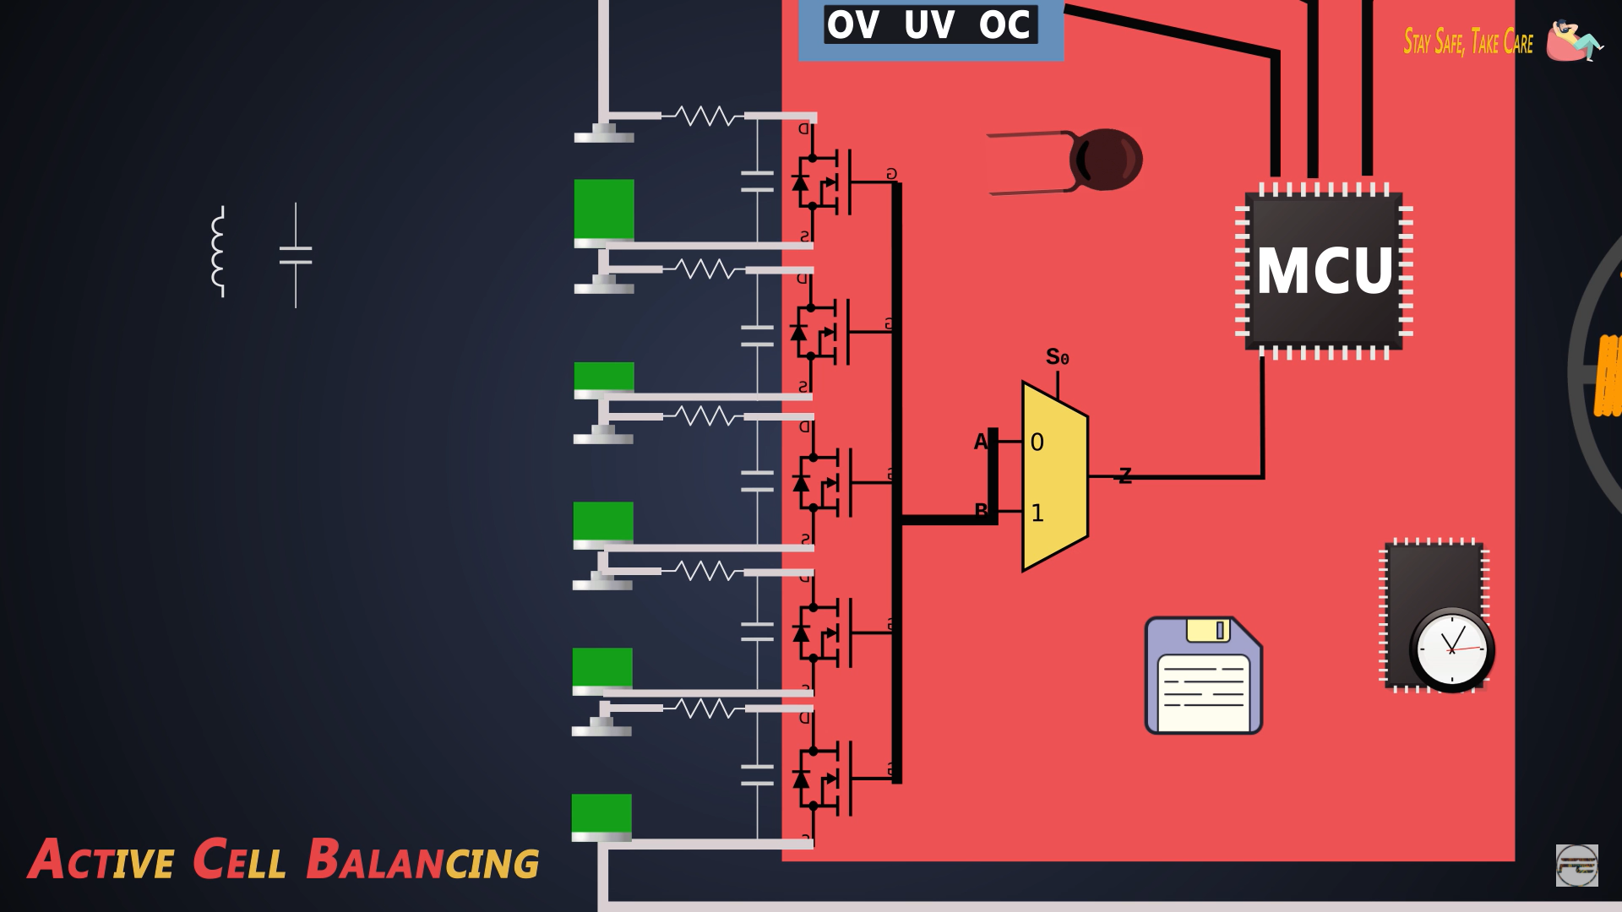
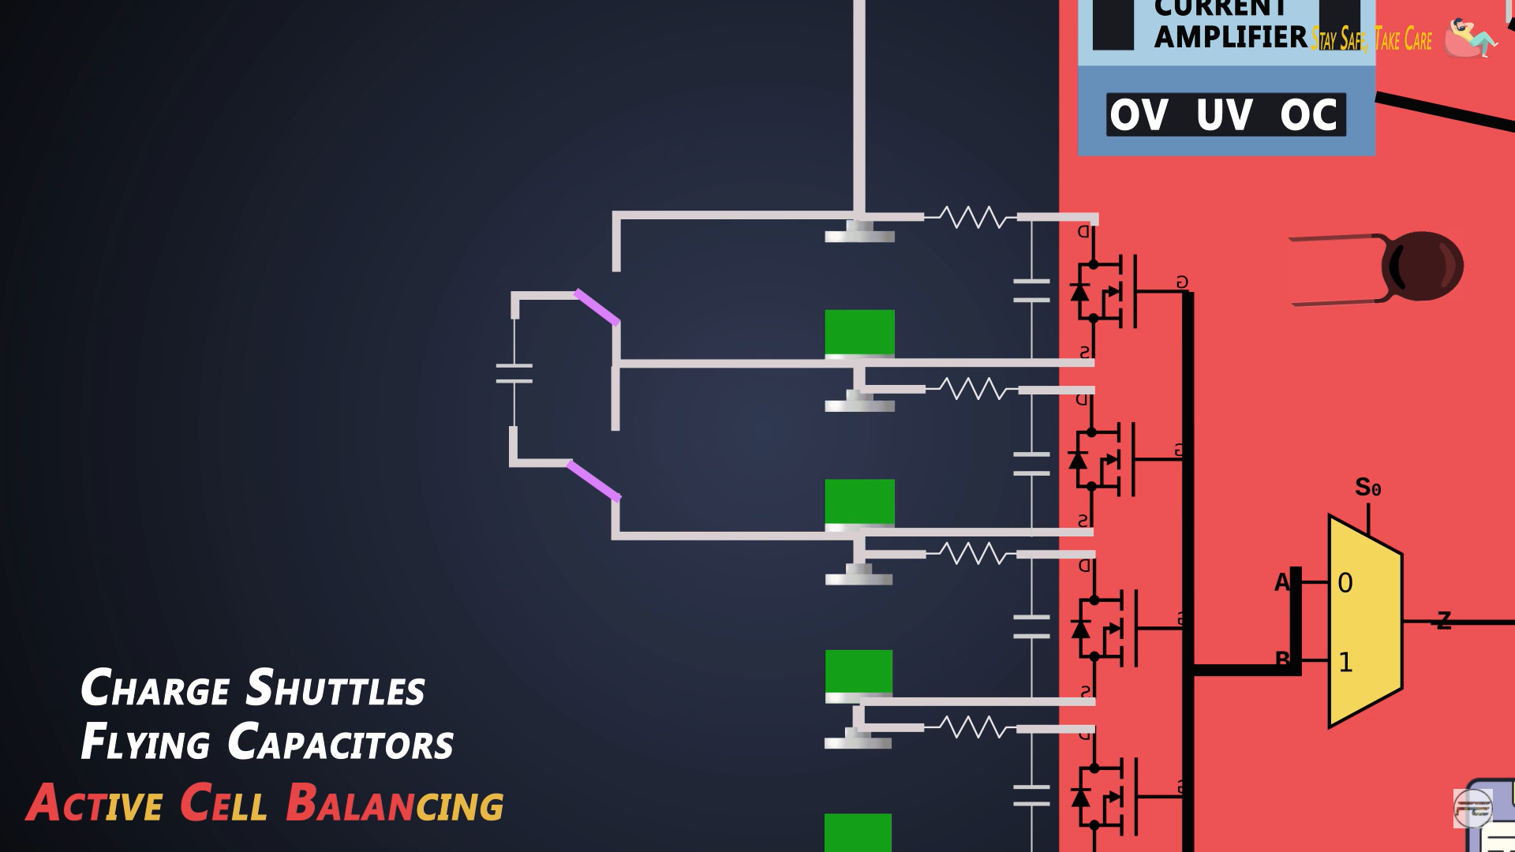
Active cell Balancing

Slide 7
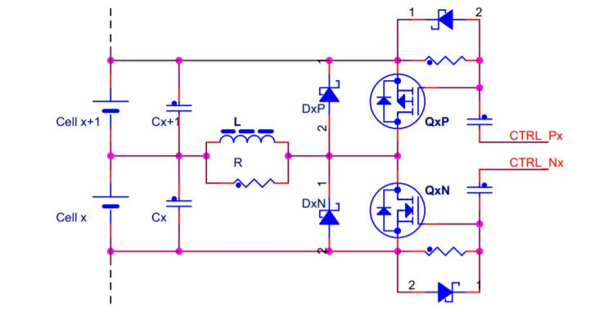
Chapter 3: Balancing Circuitry
1. Requirements for the charging state:
Control the charging process
Avoid overcharging any cell
Balance the cells during the charge state
Check the battery temperature
2. Requirements for the discharging state:
Limit the max output current of the battery pack
Avoid deeply discharging any cell
Balance the cells during discharge
Check the battery temperature
FIGURE 2: Balancing Circuitry The requirements for control are split into two main sections:

Slide 8
Temperature Monitoring:-
The analog multiplexer performs the voltage measurement of each cell and provides this information to the control MCU. The MCU runs a dedicated algorithm for correctly selecting a strong and weak cell, and determines which cell must be charged to equalize the SOC of all the cells. The maximum and the minimum cell voltages are checked simultaneously. If all the cells are fully charged, the control MCU switches off the charging state.
For the discharge state, the MCU periodically checks the voltage of each cell and the temperature of the whole battery. The current sourced from the battery is checked only if the protection module is included.
This protection avoids a short circuit or an overcurrent condition of the whole battery pack. As in the charging state, the individual cell voltages are checked periodically. All values are compared and the weaker cells are charged. This algorithm equalizes the discharge state of all the cells to provide the most available power fromQ the battery pack. If most of the battery cells are at the low voltage limit, the MCU sends a warning signal through the external interface.
This type of control of the charge distribution between all battery cells maintains the longest lifetime of the whole battery, maintains that the battery is charged with the highest amount of energy, and ensures that the battery can release the full energy to the appliance.

Slide 9
PASSIVE CELL BALANCING SIMULATION CIRCUIT

Slide 10
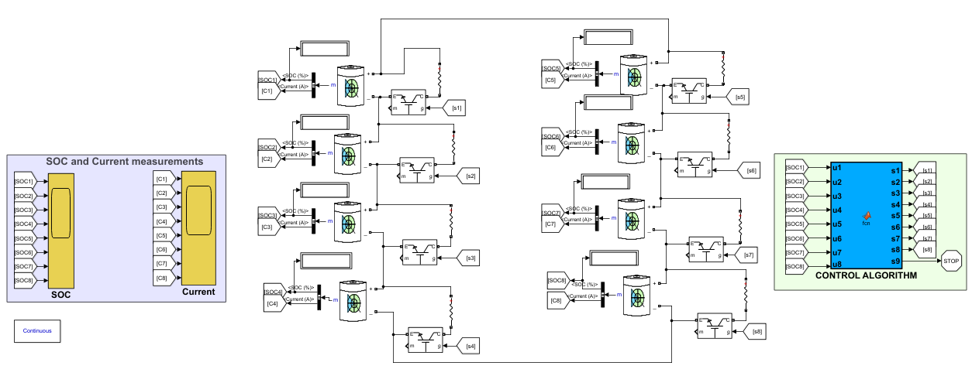
Passive cell balancing circuit

Slide 11
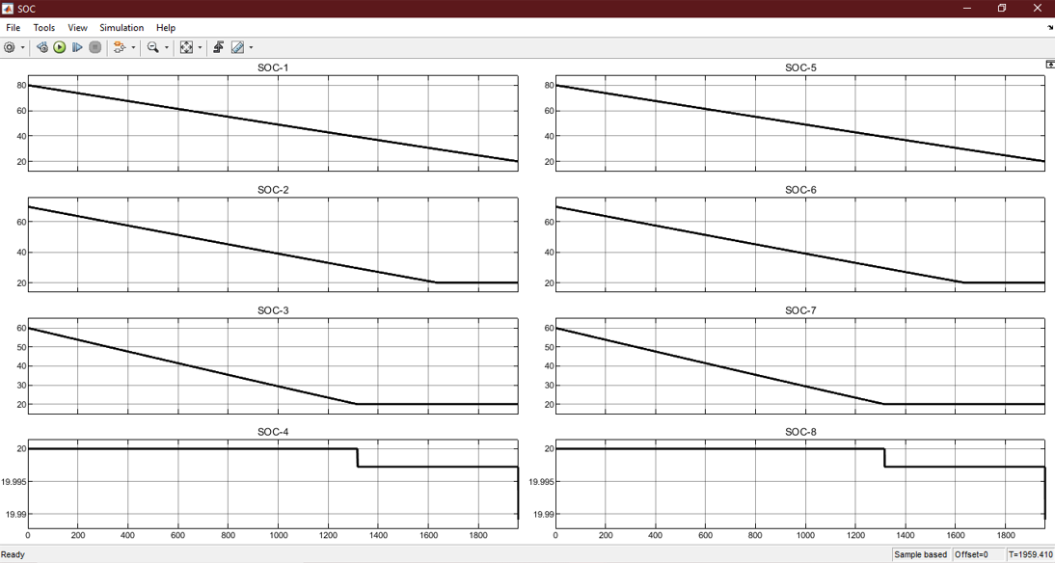
Simulation Results

Slide 12
Conclusion and Further Motives:-
Literature review Completed
Passive balancing simulation completed
Further plans
Report Formation for the passive balancing circuit
Temperature monitoring

